Slide 1
Vlerick Business School Master Class
Christopher Grumiau
March 2020
Emails: christopher.grumiau@allianz.be & georg.camehl@allianz.nl

Slide 2
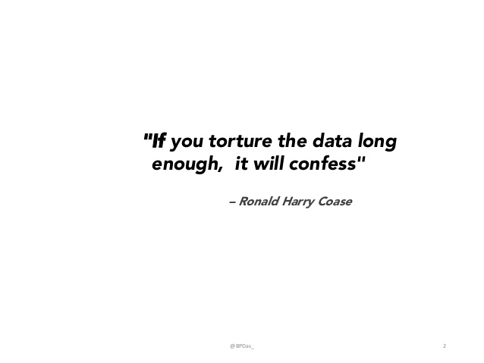

Table of content
Allianz – Presentation
Allianz – Way of Working
Process – Project and people management
Products – From ideation to Industrialization
Future – AI eco-systems
Use case

Slide 3
Table of content
Allianz – Presentation
Allianz – Way of Working
Process – Project and people management
Products – From ideation to Industrialization
Future – AI eco-systems
Use case

Slide 4




… Allianz as a company
Allianz SE is the holding company of Allianz Group and has its global headquarters in Munich.
In business for over 125 years.
Europe’s largest insurer based on market value.
One of the largest
asset managers
In the world.
Trusted Partner
for more than
88 million customers.

Slide 5




… allianz as an innovative insurer
Allianz is continuously developing innovative products, e.g. for smart homes.
Allianz insures major Hollywood and Bollywood movies including all 24 James Bond productions.
Allianz offers telematics products for connected cars.
Allianz offers financial solutions to over 58 million low-income people in Africa, Asia and Latin America.

Slide 6




… allianz as an innovative insurer
Allianz is the leading specialist in space and cyber insurance and celebrated its 100th birthday as aviation insurer in 2015.
Allianz insured the last three buildings to hold the title of “world’s tallest”: Petronas Towers, Taipei 101, Burj Khalifa.
Allianz was one of the insurers of the Titanic.
Allianz offers drone insurance products for private and commercial operators, manufacturers, repairers, flight schools and training facilities.
Allianz will become the insurer of the Olympic Games as from 2024 at Paris

Slide 7









… Allianz as an employer
38% of our leadership staff is female.
71% of our employees participated in Allianz academy training sessions.
13% of our employees work-part time.
Allianz CARES about the well-being of its employees and SUPPORTS families.
21,890 new employees were hired in 2018.
140,000+ PEOPLE work for Allianz across 70+ COUNTRIES.
Allianz supports CROSS-FUNCTIONAL and REGIONAL career paths.
670€ on average was invested in continuing education programs per employee in 2017.
There are 69 nationalities in Allianz headquarters.

Slide 8
Table of content
Allianz – Presentation
Allianz – Way of Working
Process – Project and people management
Products – From ideation to Industrialization
Future – AI eco-systems
Paper submitted by Robin Van Oirbeek and
Christopher Grumiau
Link: Framework for DS
Use case

Slide 9


Project management – Way of working (trust and story telling)
Why did we Take Off?
To increase our competitivity we need to be data driven and advanced in our analysis.
The goal is to develop a strategy to constitute a self-finance mechanism for further innovations.
The first moment when value is created from data science projects is when model outcomes are operationalized.
It requires TRUST and a good STORY TELLING.
How will we get to our destination?
We are organized to collaborate with business owners in AGILE mode by using Dev(Sec)Ops to implement use cases that create substantial impact on OP.
Our key success factors
Strategically Aligned Use cases
Good Prioritisation
Product Owners are Senior managers and from business owning the Analytics Domain.
They are responsible and accountable for
Identification and initiation
Management Action required for succesfull implementation ot AA modelling outcomes
They escalate into Data Executive Board
Dedicated Management Action
AA Approach and Results
+
Management Action
=
Business Case
Relevant Data
Mix skills
Excellent
AA Capabilities
Visual
A lot of challenges:
Misconception of data: CEO, CTO and CDO have a different view on data
Etthic / legal point of view: the insurance world is highly regulated
Culture / change takes time for everyone in the company
Garbage In = Garbage Out: do not forget to invest on data as well IT constraints
Project / Data management
Data governance: it is about finding, trusting and understanding data. It is a habit to be put in place as soon as possible to control mechanism to ensure that the habits turns into a culture.
Start small
Use feedbacks and 4 eyes
Fail fast to learn fast and to improve
Our key success factors
Collaboration
Strategically Aligned Use cases
Dedicated Management Action
Relevant Data
Excellent
AA Capabilities
Persistency
to learn and improve
Collaboration

Slide 10
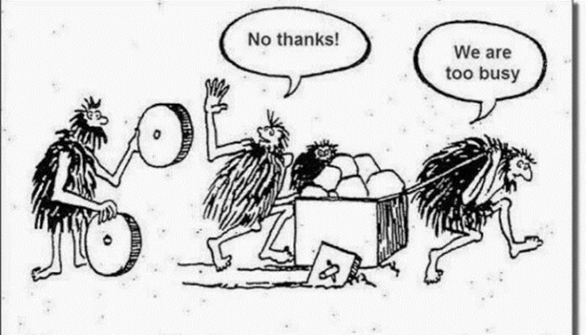
Some quotes regarding project mngt!!!
“Without data, you are like another man with opinion.” Edward Deming
“Share your knowledge, it is a way to achieve immortality.” Dalai Lama
“In weak companies, politics wins. In strong companies, best ideas win.” Steve Jobs
“Secret of change is to focus not on fighting the old process but building on the new.” Socrate
“If somebody offers you an amazing opportunity but you are not sure you can do it, say yes and learn how to do it later.” Richard Branson

Slide 11
People management
Why did we Take Off?
To increase our competitivity we need to gather the best talents.
Data scientists are not seen by the business as simple model providers but as equal providers of the company’s results and contributors to the operating profit.
How will we get to our destination?
Our key success factors
R&D at least 20% of time with possibilities to publish results
Mix expertise: engineering, machine learning, statistics, IT, architecture, business, etc.
Brainstorming sessions to encourage creativity
Effective tooling: OPEN source
Visual
Mix Mindset: PhD, advisors, etc.
Our key success factors
Collaboration / Communication
Strategically Aligned Use cases
Dedicated Management Action
Relevant Data
Excellent
AA Capabilities
Persistency
to learn and improve
Collaboration

Slide 12
Still a few QUOTES
“No-one ever made a decision because of a number, they need a story.” Daniel Kahneman
“Not everything we count counts, not everything that counts can be counted” Albert Einsteïn
“No one has ever changed the world by doing what the world has told them to do.” Eddy Zhong
“In god we trust, all others bring data.” Ed Deming
“Courage is to be able to step up and speak, it is also the ability to stay seated and stay quiet.” Richard Branson
“The value of learning is zero, the value of doing is infinite.” Anthony Bradshow
“Respect is how to treat everyone, not just those you want to impress.” Richard Branson
Visual
“Train people enough so they can leave, treat them well enough so they do not want to.” Richard Branson
“You do not hire smart people to tell them what to do but you hire them to tell you what to do.” Steve Jobs
“The only thing worse than training an employee and seeing him to leave is to not train him and see him to stay.” Ford
Our key success factors
Strategically Aligned Use cases
Dedicated Management Action
Relevant Data
Excellent
AA Capabilities
Persistency
to learn and improve
Collaboration

Slide 13
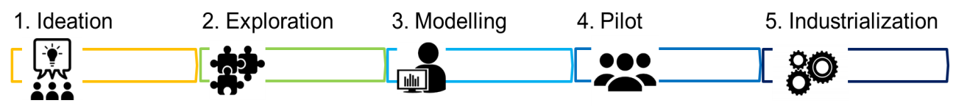
Products: from ideation to industrialization
Working in AGILE mode, the process has to be handled for each MVP (miminal valuable product).
Ideation
Exploration
Modelling
Pilot
Industrialisation
Setting up of the target MVP and commitment from all stakeholders
Keys:
Alignment between all stakeholders
Alignment on needs
Squad set-up
Define unique KPI
Costs and budget are agreed
Data gathering, understanding and setting up of the modeling strategy
Keys:
Detect data dependencies/availabilities
Provide data quality score
HUBs to be planned
Dash-boarding (most of the time already providing value to business)
To build the pipeline and to develop the model – main core of data scientists
Keys:
Be pragmatic
Data preparation for modelling including distribution analysis
Quick and dirty benchmark model
Full model pipeline
Error analysis including costs
Model validation: out-of-time, K-fold cross, confusion matrix, C-index, ROC, Lorenz, etc.
To validate the model business-wise and show-case the gain – KPI to be achieved
Keys:
Real life context
Build Application for final users
Add interpretability (different from explainability):
LIME
SHAP
VINE
To govern and to ensure the effective use of the solution by the final users and the business.
Keys:
Congrats the team but not celebrate (yet ☺)
Separate production and release dates
Separate release dates from operations
Plan refit, monitoring and training regime (it takes time and is a long-term process)
Visual
Our key success factors
Strategically Aligned Use cases
Dedicated Management Action
Relevant Data
Excellent
AA Capabilities
Persistency
to learn and improve
Collaboration

Slide 14
Last QUOTES… but not least!
“If you want to use something new then you have to stop doing something old.” R.F. Drucker
“All models are wrong but some are useful.” George Box
“If things are not going right then go left.” R. Branson
Visual
“Mathematics is not about numbers, equations, computations or algorithms, it is about understanding.” W.P. Thurston
“You do not learn to walk by following rules. You learn by doing and by falling over.” R. Branson
Our key success factors
Strategically Aligned Use cases
Dedicated Management Action
Relevant Data
Excellent
AA Capabilities
Persistency
to learn and improve
Collaboration

Slide 15


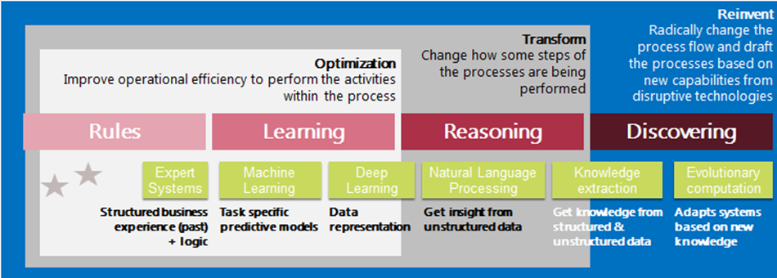
Future: Let’s dream but first thing first - let’s try to not boil the ocean and enjoy the journey!!!
FUTURE
Lessons learned
Enablers
Good knowledge from Web, public data, etc.
Good label data
Human expertise/Deep reinforcement learning
Automated machine learning
Adaptive learning
Rules
Learning
Reasoning
Discovering
Expert system
Based on past and logic
NOT exhaustive
NOT scalable
Level in insurance:
Good
Machine learning
Deep learning
Based on past data - predictive models and data representation
Requires manual expertise and time consuming to fit
Level in insurance:
Mature
NLP
Knowledge extraction – entity recognition, sentiment analysis, etc.
Focus on the need to link semantic meaning with model problems
Level in insurance:
Mature
Evolutionary computation to adapt systems in real time
Link with genetic algorithm
Level in insurance:
R&D

Slide 16
Table of content
Allianz – Presentation
Allianz – Way of Working
Process – Project and people management
Products – From ideation to Industrialization
Future – AI eco-systems
Paper submitted by Robin Van Oirbeek and
Christopher Grumiau
Link: Framework for DS
Use case

Slide 17
Use Case: Bootcamp Data Science for Finance & Strategy
Allianz Benelux &
Vlerick Business School
March 16th to 20th

Slide 18
Content Topics
01 | Challenge: Analyse data to Improve Direct Sales Channels
02 | Data
03 | Business Questions & Workflow
04 | Organization

Slide 19
1. The insurance world is changing
Historically, insurances are sold through insurance brokers acting (mostly) independently from insurance companies
The retail business (in particular) is transforming to more digital channels
While historically, insurance companies were not facing the customer, this is also changing
There are many different ways how this could happen:
Direct insurance (e.g. Allianz Direct)
Brokers are setting up digital channels of their own
Insurance companies cooperate with third parties who have an interest in selling some sort of insurance → These third parties are called affinities

Slide 20
2. Where does the data come from?
In the Netherlands we are working with one affinity called PMA (https://pma.info/), they mostly sell health insurance, but also car insurances
There exists a quote and buy system for car insurances: Potential customers can put in their information, directly get a quote for how much it would cost and can then directly buy it
Data we provide for the use case:
Quotes that were given through sales funnels, including those given to PMA from October 2018
Policies Allianz has through PMA (status of October 2019)
Claims to policies Allianz has through PMA (from January 2014 to October 2019)
Sociodemographic data on the zip code level

Slide 21
2. What does the data look like?
There is one row in the quote dataset for each quote, the policy dataset has one row per contract, the claims dataset one row per claim, the regional data has one row per zip-code
Quotes (these can come through PMA or other parties): 9374 rows, 18 columns
Policies (only PMA): 13365 rows, 26 columns
Claims (only PMA): 14809 rows, 14 columns
Regional (all zip-codes that appear in 1 or 2): 14807, 34 columns
A data dictionary gives short descriptions on the columns, as well how the tables can be linked with each other

Slide 22
3. Recommended workflow
Create a workspace / directories
Load packages and datasets
Check dimensions and types of variables
Inspect the data for outliers, implausible, and missing values
Apply corrections such as dropping outliers, imputing missing values (be careful if you want to do this before or after descriptive statistics)
Merge tables and cross-check
Feature engineering: Generate additional variables from the available data
Generate uni- and multivariate descriptive statistics and plots
Apply machine learning algorithm
Check results and iterate

Slide 23
3. What are our customers like (1)?
Descriptive data analysis
Goal: Analyse the data to create overviews in the form of summary statistics, uni- or bivariate plots, maps, etc., to give descriptive insights about who uses the online sales funnel
Why?
Before moving to more advanced techniques, it is important to understand the data in detail. Often simple plots already create great value, but they have to carefully crafted (both form a technical and communication point of view)
Hints:
Use data analysis to gain focus on the exact business question you want to answer and to create the basis for your story
This step is often also helpful to find anomalies in the data and to apply corrections

Slide 24
3. What are our customers like (2)?
Application of unsupervised learning
Goal: Identify segments and find out how the customers within these are similar (and how they differ from other groups
Why?
Clusters can be used for personalized marketing actions, to adapt products sold on the channel or the channel design itself; for the customer this means we can service them on their needs (e.g. at the moment the PMA website seems to be used more by men)
Hints:
Select (few) features that are relevant from business point of view to apply clustering algorithms
Is it possible to derive profiles from the clusters? I.e. what are the customer groups like?
Some visualization of the results would be great but is not easy to do (try e.g. principal components of clusters)

Slide 25
3. Who are the ones who buy?
Application of supervised learning
Goal: Predict the conversion of customers using machine learning
Why?
To identify customers which are most likely to convert for new business acquisition actions, to efficiently retarget drop-outs from the funnel or to optimize the funnel
Hints:
Split the data in a training and test set (should it be possible for a customer to appear both in test and training sets?)
Create two or three different (nonlinear) classification models and compare result
Which are the most important features for predicting conversion, can you think of business actions derived from these? Can you identify points in the funnel where customers drop out?

Slide 26
4. How to continue from here?
Meeting on Wednesday to take questions and give feedback (webex)
In the meantime you can send questions (batch via organizers on a daily basis)
Final presentations of the project on Friday 20nd of March
Please don’t share the data, while it has been anonymized, it still remains property of Allianz Benelux

Slide 27
Thank you for your attention What was your favorite quote?
FUTURE

